Slide 1
Theory of Automata
Lecture # 10
Imtiaz Ahmed
sites.google.com/site/kiuskardu

Slide 2
Kleene’s Theorem
Kleene’s Theorem Part I
If a language can be accepted by an FA then it can be accepted by a TG as well.
Kleene’s Theorem Part II
If a language can be accepted by a TG then it can be expressed by an RE as well.
Kleene’s Theorem Part III
If a language can be expressed by a RE then it can be accepted by an FA as well

Slide 3
Proof(Kleene’s Theorem Part III)
If the language can be expressed by an RE then there exists an FA accepting the language.
As the regular expression is obtained applying addition, concatenation and closure on the letters of an alphabet and the Null string

Slide 4
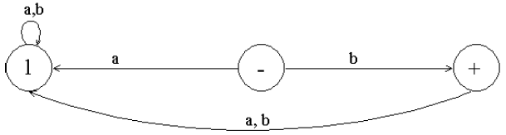
Proof(Kleene’s Theorem Part III) Contd..
So while building the RE, sometimes, the corresponding FA may be built easily, as shown in the following examples
Example
Consider the language, defined over Σ = {a,b}, consisting of only b, then this language may be accepted by the following FA

Slide 5
Proof(Kleene’s Theorem Part III) Contd..
If r1 and r2 are regular expressions then their sum, concatenation and closure are also regular expressions
So an FA can be built for any regular expression if the methods can be developed for building the FA’s corresponding to the sum, concatenation and closure of the regular expressions along with their FAs.

Slide 6
Method1 (Union of two FAs)
Using the FAs corresponding to r1 and r2 an FA can be built, corresponding to r1+ r2.
This method can be developed considering the following examples
r1 = (a+b)*b
r2 = (a+b )*aa(a+b )*

Slide 7
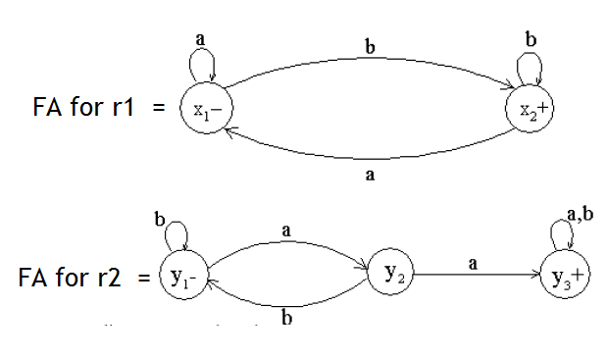
Corresponding FA’s for “r1” and “r2”

Slide 8
Method1 (Union of two FAs) Contd..
Let FA3 be an FA corresponding to r1+ r2, then the initial state of FA3 must correspond to the initial state of FA1and the initial state of FA2.
Since the language corresponding to r1+ r2 is the union of corresponding languages L1 and L2, consists of the strings belonging to L1or L2 or both, therefore a final state of FA3 must correspond to a final state of FA1 or FA2 or both.

Slide 9
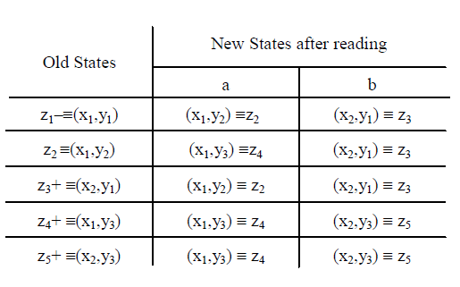
Method1 (Union of two FAs) Contd..

Slide 10
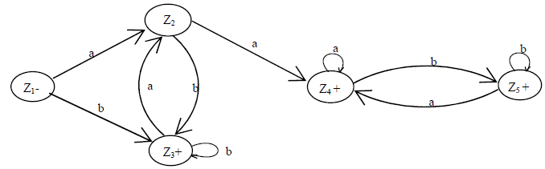
Method1 (Union of two FAs) Contd..
Using the truth table we will have following FA3 which is the union of FA1 and FA2 corresponding to r1 and r2
RE corresponding to the above FA may be r1+r2 = (a+b)*b + (a+b )*aa(a+b )*

Slide 11
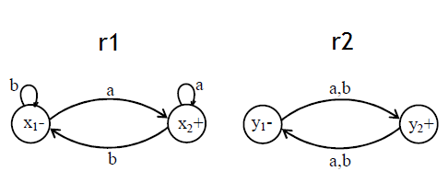
Method1 (Union of two FAs) Contd..
Let r1 = (a+b)*a and r2 = (a+b)((a+b)(a+b))*

Slide 12
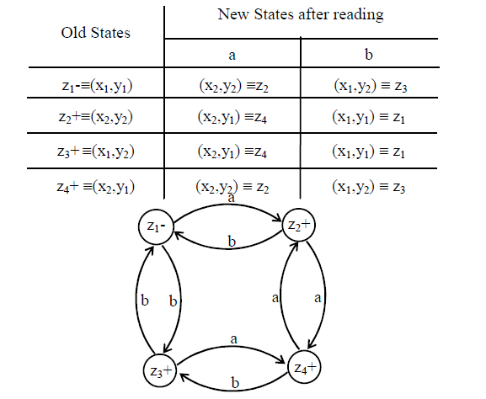
Method1 (Union of two FAs) Contd..

Slide 13

Thanks!

